Slide 1
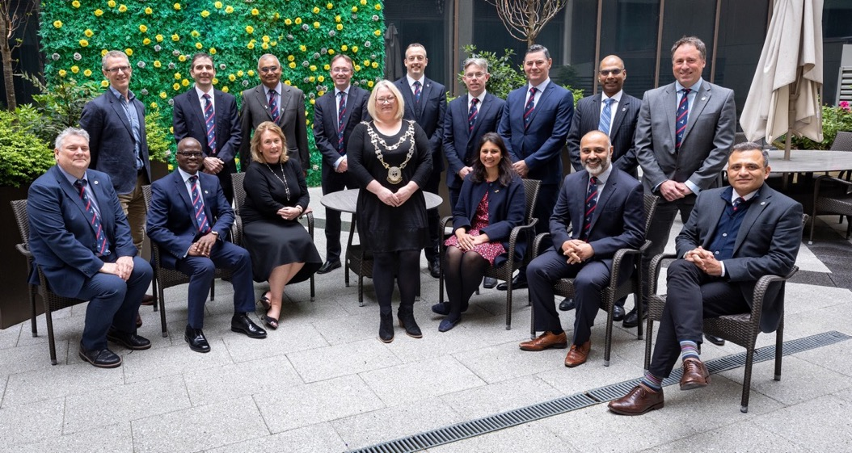
The Vascular Society
ANNUAL GENERAL MEETING 2023
VS ASM, Convention Centre, Dublin.

Slide 2
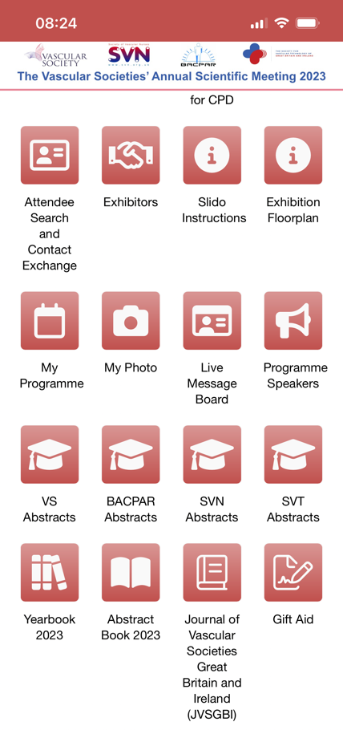

President
Busy year, notable for all the industrial action
Thank you for completing our surveys
– council wants to advocate for the members of the society
Notable headlines:
  Sexual Misconduct in surgery report
  Dame Averil Mansfield DBE FRCS FRCP
Yearbook 2023 available on app

Slide 3
Your 2023 Council
2022-23 Representatives
SAC Ginny Bowbrick
RCS Eng. Rob Sayers SAS&LED Tatiana Martin
Rouleaux Claire Dawkins Ibrahim Enemosah
2022-23 Elected Council
Rachel Bell (President) Paddy McCleary, Douglas Orr, Ian Hunter, Ciaran McDonnell, Marcus Brooks, Paddy Coughlin, Sadasivam Selvakumar, Andrew Garnham, Meryl Davis, Lucy Wales, Marco Baroni, Ansy Egun, Ian Chetter, Rao Vallabhaneni, Matt Bown, Bridget Egan, Arun Pherwani , Ian Loftus and Chris Imray.
Elected Council (Trustees)
President
Vice-President
Vice-President Elect
Honorary Secretary
Honorary Treasurer
Committee Chairs ¹
Elected Members ²
SAS and LED Representative
Open Council
Elected Council
SAC representative
RCS Eng. vascular specialty lead
Rouleaux representative
SVN President
SVTGBI President
BSIR President
BACPAR President
RSM Venous Forum President
Seven Society Committees ³
Executive
Professional Standards
Education & Training
Research
Audit & Quality Improvement
Workforce
Annual Scientific Meeting
Excludes Professional Standards chair. Committee chair shadows may also attend (ex-officio).
Elected by the membership for 3-year term of office as Trustees.
Chair, elected members, affiliated society members and seconded attendees.

Slide 4
Honorary Secretary
  Sign off minutes of 2022 AGM (23rd Nov 2022)
  New elected council members
  Membership category changes
  Engagement survey
  In memoriam

Slide 5
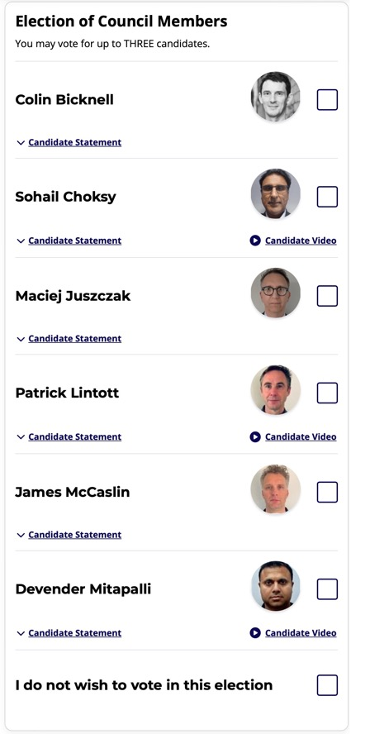
Elected Council
New Council Members
(2023-2026)
Colin Bicknell London
Patrick Lintott Oxford
James McCaslin Newcastle

Slide 6

Membership categories
Category | Eligibility | Voting
Full | Consultant or Specialist vascular surgeon working in UK or Ireland. | ☑️
Overseas | Consultant vascular surgeon working outside of UK or Ireland.
Associate | Specialist (SAS) or Locally employed (LED) doctor working in UK or Ireland ¹ Scientist working in the field of vascular disease Medical Allied Professional (PA, SCP or AA). Allied HCP (Podiatrist etc)
Affiliate – Specialty ² | Higher Specialty trainee (ST3+ Vascular surgery) SAS/LED doctor preparing for CESR
Affiliate – Pre-specialty | Core surgical trainee (ST1/2), Foundation Trainee (F1/2) and Medical student
Retired
Honorary
Reciprocal ³ | SVN, SVTGBI, VASGI, BSIR and BACPAR members represented on Open Council.
Except if chooses Affiliate – Specialty membership
Membership includes trainee membership of ESVS
Defined range of rights and privileges, without conferring membership.

Slide 7


Engagement survey
Launches January 2024

Slide 8
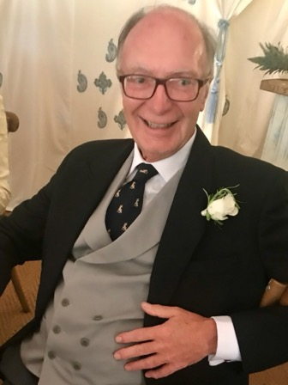
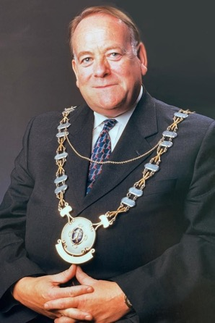
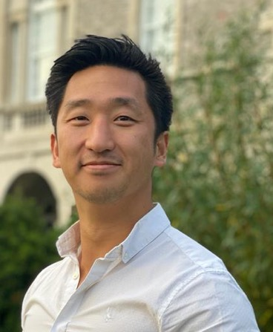
In Memoriam
We also remember
Wendy Hayes
July 2023
Nurse Consultant Worcestershire Acute NHS Trust
Paul Anthony Edmund Hurst
September 2023
Consultant in Brighton
Professor Roger
Malcolm Greenhalgh
October 2023
Consultant in London
Past President VS
Simon Sai-Hang Lau
October 2023
ST3 year of training
in Sheffield
Simon’s parents attending on Friday

Slide 9
Honorary Treasurer
  Financial report
  Membership subscriptions
RESOLUTION 1: Agree finance plan for 2023/24

Slide 10
Income and Expenditure 2022/23
Charitable activities £ 501 844
Donations and legacies
Restricted £ 201 908
Unrestricted £ 65 101
Fund Raising £ 1 968
Investments £ 18 743 2021/2022
Income £ 789 564 £812 223
Expenditure £ 685 667 £681 193
Surplus £ 102 157 £131 030

Slide 11
Society Funds - reserves as of June 2023
CAF Bank £ 866 395
Rathbones £ 441 470
Total £ 1 307 865
Restricted funds
Venous Forum £ 5 000
Health Education England £ 376 653

Slide 12
VS Commitments 2023/24
Research Fellowship Grants
RCS Ed. x 1 £40 000
RCP&S Glasg. x 1 £40 000
RCR/BSIR x 1 £ 25 000
Clinical Fellowship Grants
Aortic Fellowship £35 000
Other funded activity
RCS Eng. SSLs x3 £ 22 500 *
ASPIRE £ 90 000
JVSGBI £ 20 000 **
VS&CF Websites £ 60 000
* May reduce as 1 SSL stands down
** Will reduce due to sponsorship

Slide 13

Membership and Subscriptions
Membership numbers (Oct 2023)
Ordinary 380 (370) {380}
Associate 26 (23) {24}
Affiliate 90 (85) {109}
Overseas 12 (10) {11}
Senior 41 (43) {42}
Honorary 34 (34) {34}
Figures in () from May 23, Figures in {} from Oct 22
Subscription rates 2023/24
Ordinary £ 250 £300
Associate £ 140
Affiliate £ 115
Overseas £ 115
Senior £ 45
Honorary N/A
Donation preference (Ordinary members)
A regular donation of £50.00 to the CF, the UKs only dedicated vascular charity, will be automatically added to your membership price.

Slide 14
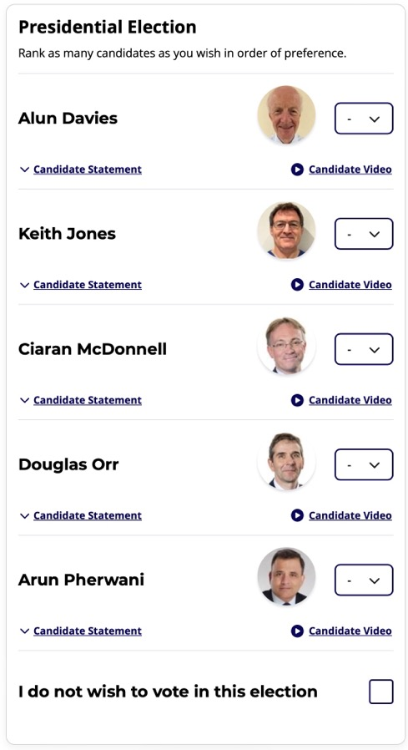
Vice-President
Your newly elected President for 2025-26
…..

Slide 15
Honorary Secretary
  5. Any other business
To follow:
17:00-18:00 Joint Symposium: The ideal amputation/ amputee
18:00-18:30 Welcome Reception
18:30-19:00 SVN Evening symposium: The Influence of Human Factors on Performance in High-Income and Variable-Resource Contexts. Fiona Kerray, VS/CF Research Fellow
19:00-22:00 SVN Drinks Reception
Date and venue of next AGM
Wednesday 27th November 2024
Hilton Metropole, BRIGHTON

